Slide 1

Blogger Boost: Know Yourself and Your Community
Elena Dubova @Metis
June 2020

Slide 2
01
TABLE OF CONTENTS
02
03
BUSINESS CASE, TOOLS & DATA
TOPIC MODELING: BLOGGER COMMUNITY ANALYSIS
BLOGGER BOOST WEB APPLICATION DEMO

Slide 3
01
Business Case, Tools & Data

Slide 4
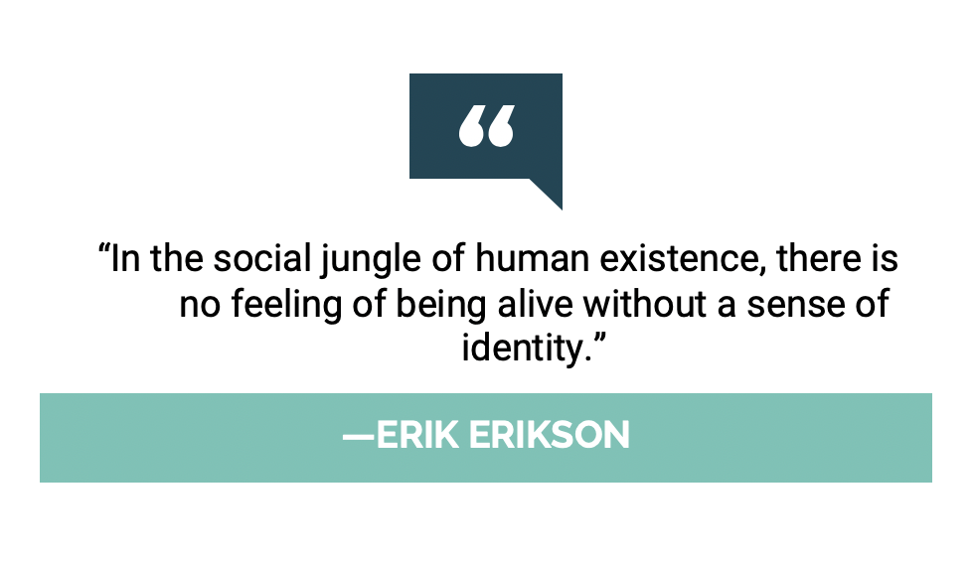


BUSINESS CASE
DATA
dual impact of the internet
new opportunities like blogging itself
another level of abstraction and uncertainty
risks of social interaction
blog authorship corpus
source: blogger.com
format: XML
balanced demographics: gender, age
size: 19K+ bloggers
300K+ posts
78M+ words

Slide 5
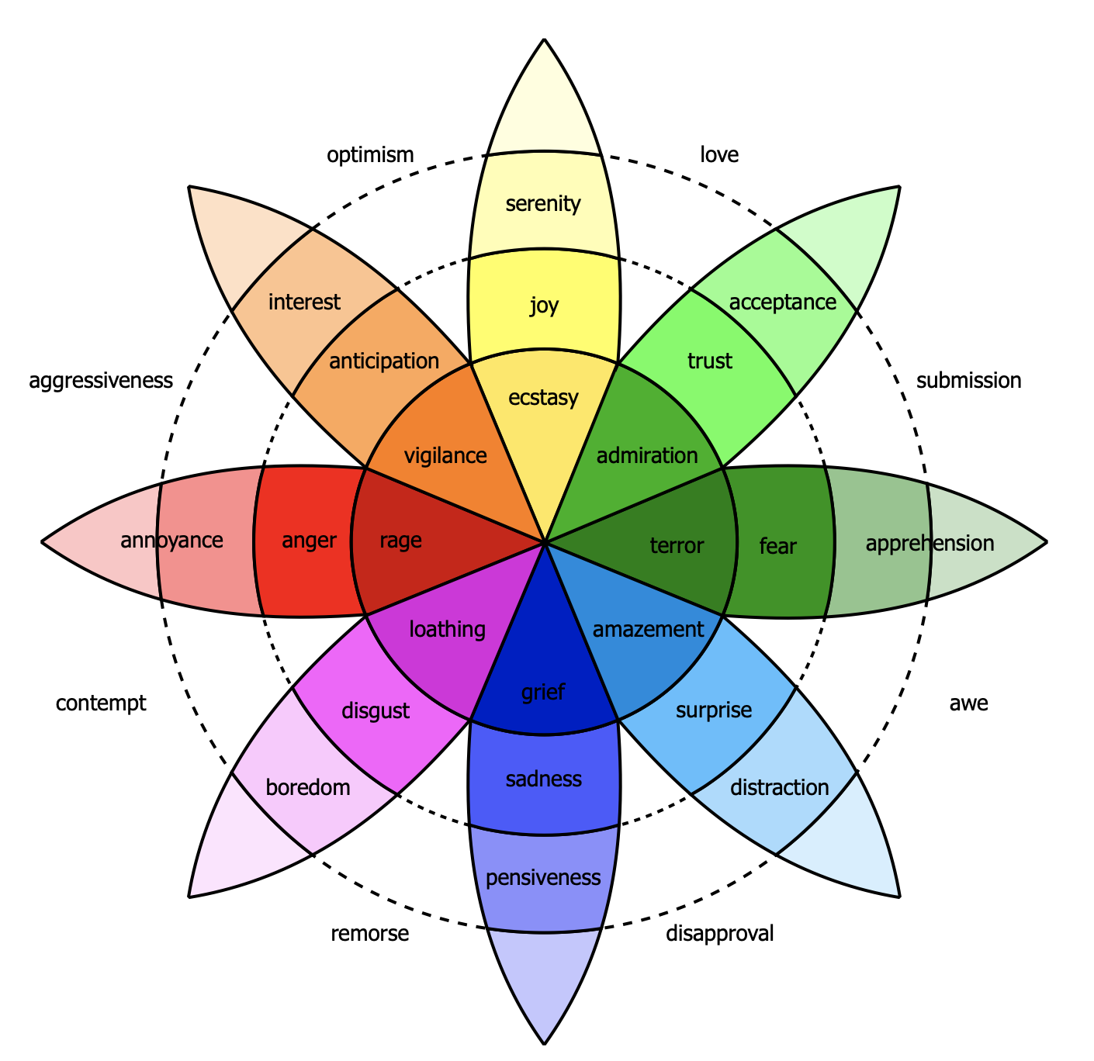







Tools
Product
BLOGGER BOOST
WEB APPLICATION
COMMUNITY
VISUALIZER
SELF-AWARENESS
DASHBOARD
Notes:
COMMUNITY VISUALIZER: identifies a blogger to a community map based on the topics of their blog
SELF-AWARENESS DASHBOARD - shows emotions and polarity trends over blogging history

Slide 6
02
Community Clustering with Topic Modeling

Slide 7
TOPICS*
﻿Days of My Life
go
day
night
home
time
work
Teen Spirit
lol
school
fun
kinda
cool
stuff
Relationships
know
love
want
feel
people
friends
Slang People
lor
wad
cos
noe
ppl
dunno
Politics
bush
kerry
iraq
war
president
people
Faith
god
church
jesus
life
lord
christ
Leisure
blog
people
new
book
game
music
*algorithm: Non-negative Matrix Factorization with TF-IDF vectorizer

Slide 8
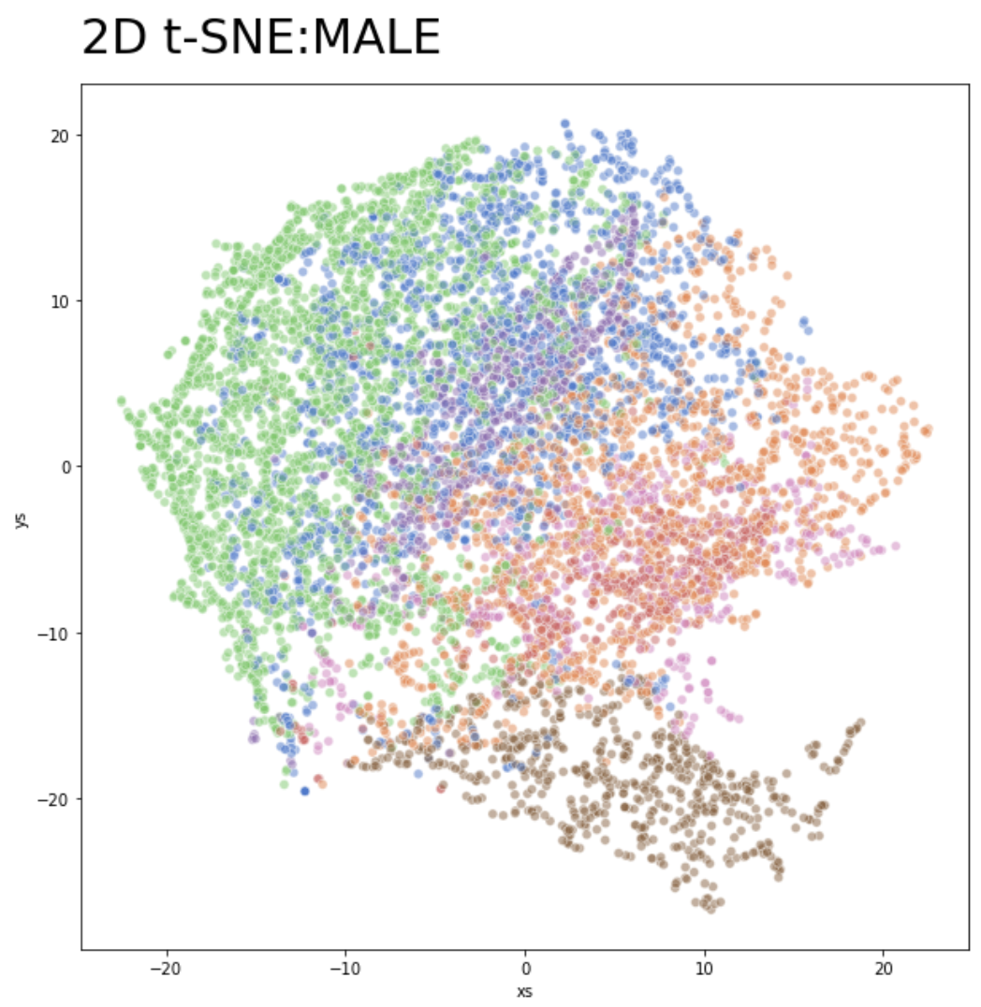
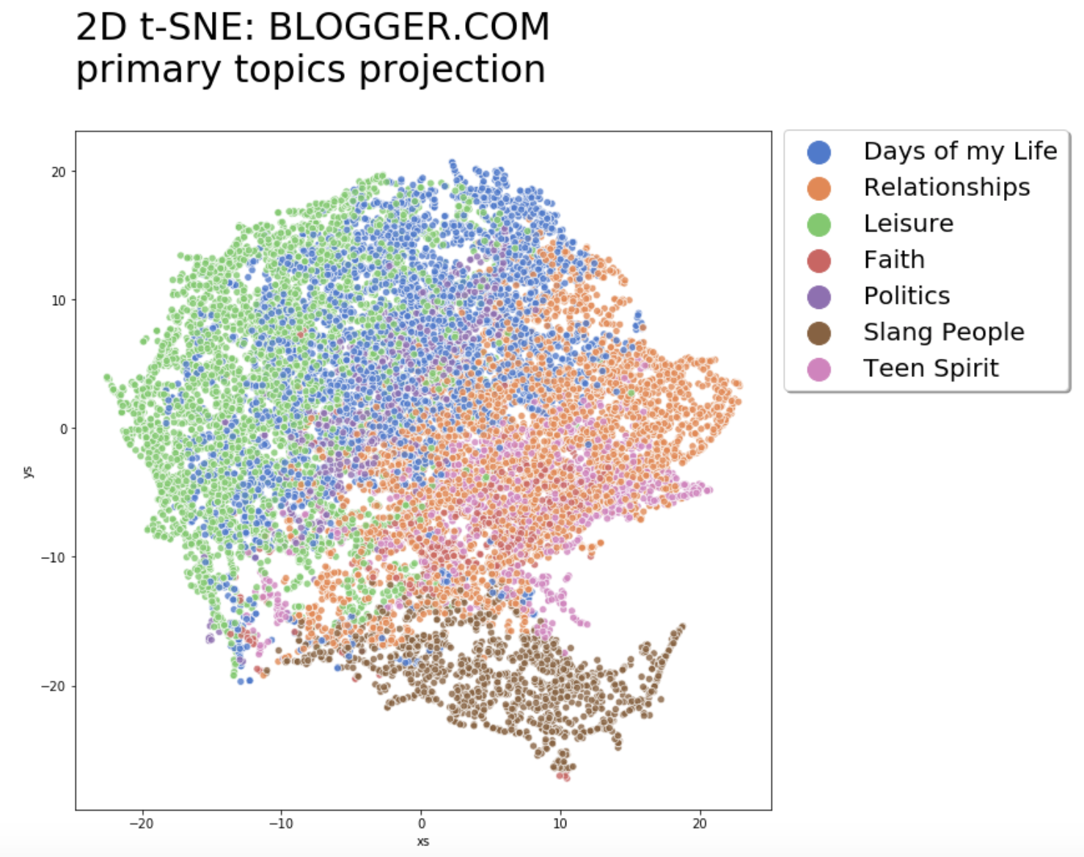
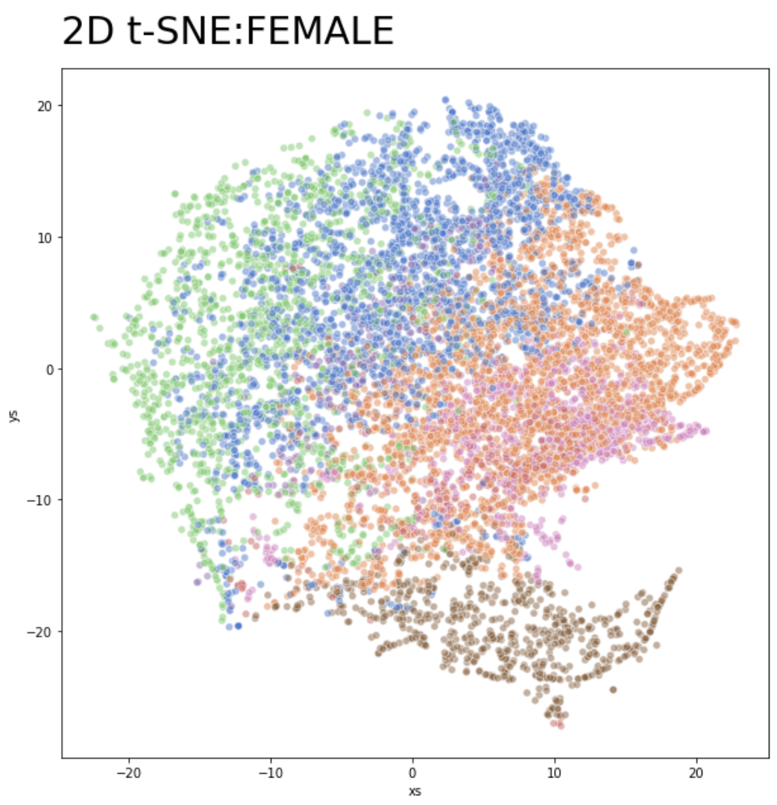
2D t-SNE BLOGGER.COM primary topics projection
Leisure

Slide 9
2D t-SNE BLOGGER.COM primary topics projection
Relationships

Slide 10
2D t-SNE BLOGGER.COM primary topics projection
Faith?

Slide 11
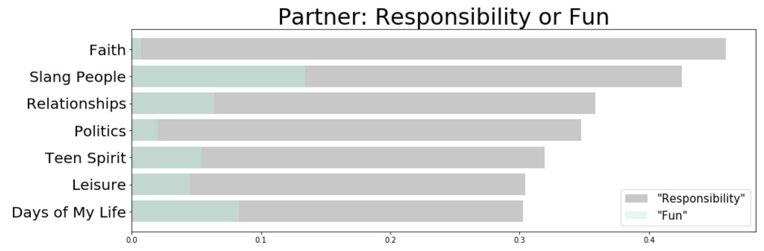
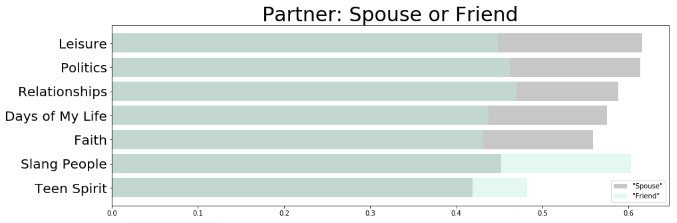
Semantics across Communities
“partner”
﻿Days of My Life
spouse, husband, companion
Teen Spirit
parents, sibling, life
Relationships
spouse, girlfriend, wife
Slang People
girlfriend, boyfriend, supervisor
Politics
spouse, colleague, employer
Faith
family, mentor, equipping
Leisure
spouse, supervisor, teammate
Notes:
Here I investigate the context to infer word meaning across different communities clustered using topic modeling. To build word embeddings I leverage the distributional hypothesis word meaning can be understood from the neighboring words.

Slide 12
03
Blogger Boost Demo

Slide 13
NOTE ON ETHICS
The application uses sensitive personal data, such as description of feelings and emotions.
Any implementation of this prototype in production environment requires that data are treated as confidential, are owned and controlled by the user alone.
Usage of analysis output or data for any purpose other than maintenance of personal well-being violates ethical norms.

Slide 14
THANK YOU
do you have any questions?
email: elena@dubova.net
GitHub repo: https://github.com/elena-du/Blogger_Boost.git

Slide 15
Appendix

Slide 16
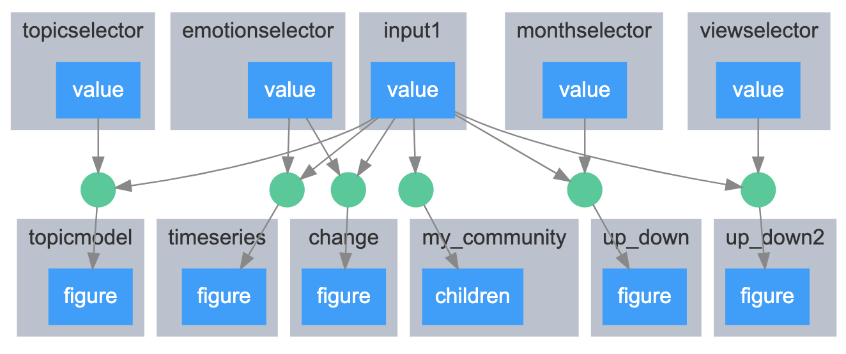
Blogger Boost: Conceptual Architecture

Slide 17
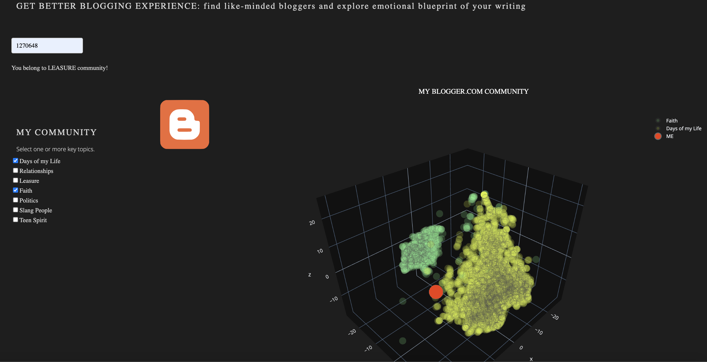
Blogger Boost: Community Visualizer

Slide 18
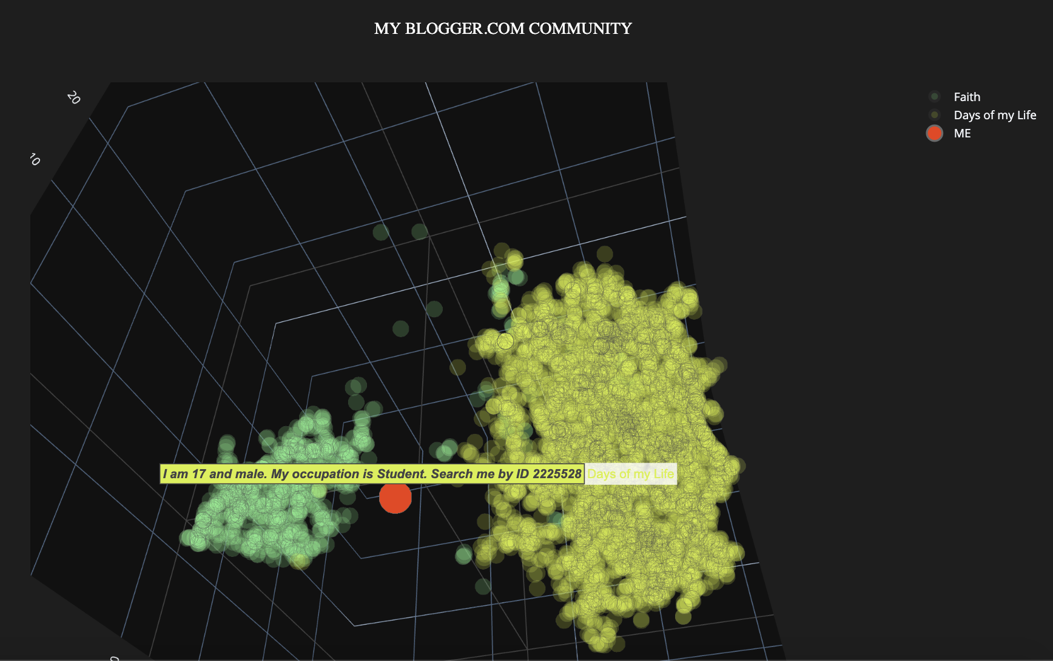
Blogger Boost: Community Visualizer

Slide 19
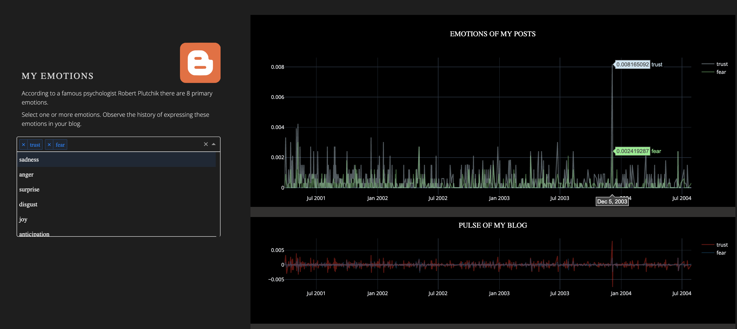
Blogger Boost: Emotional Profile

Slide 20
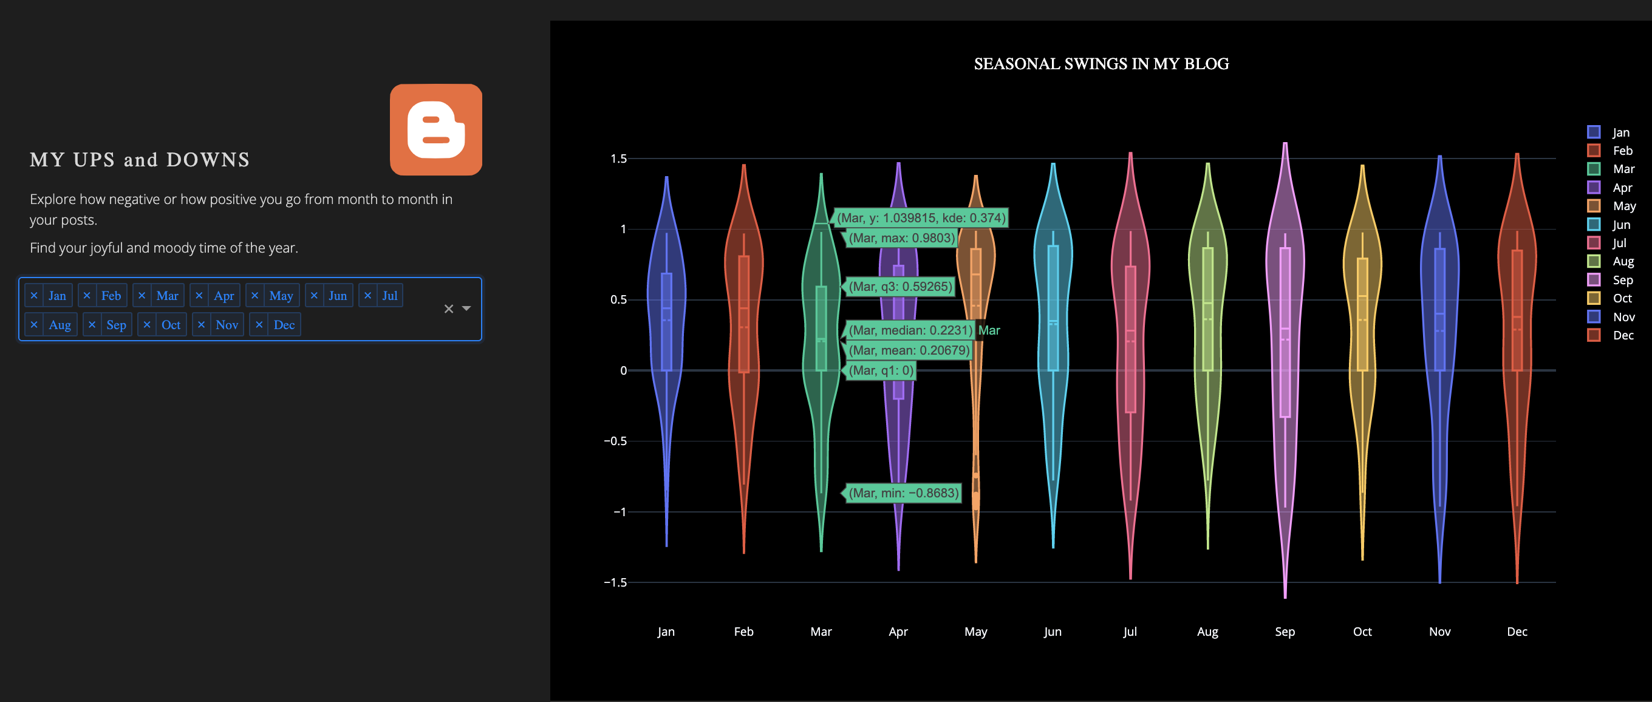
Blogger Boost: Emotional Profile

Slide 21
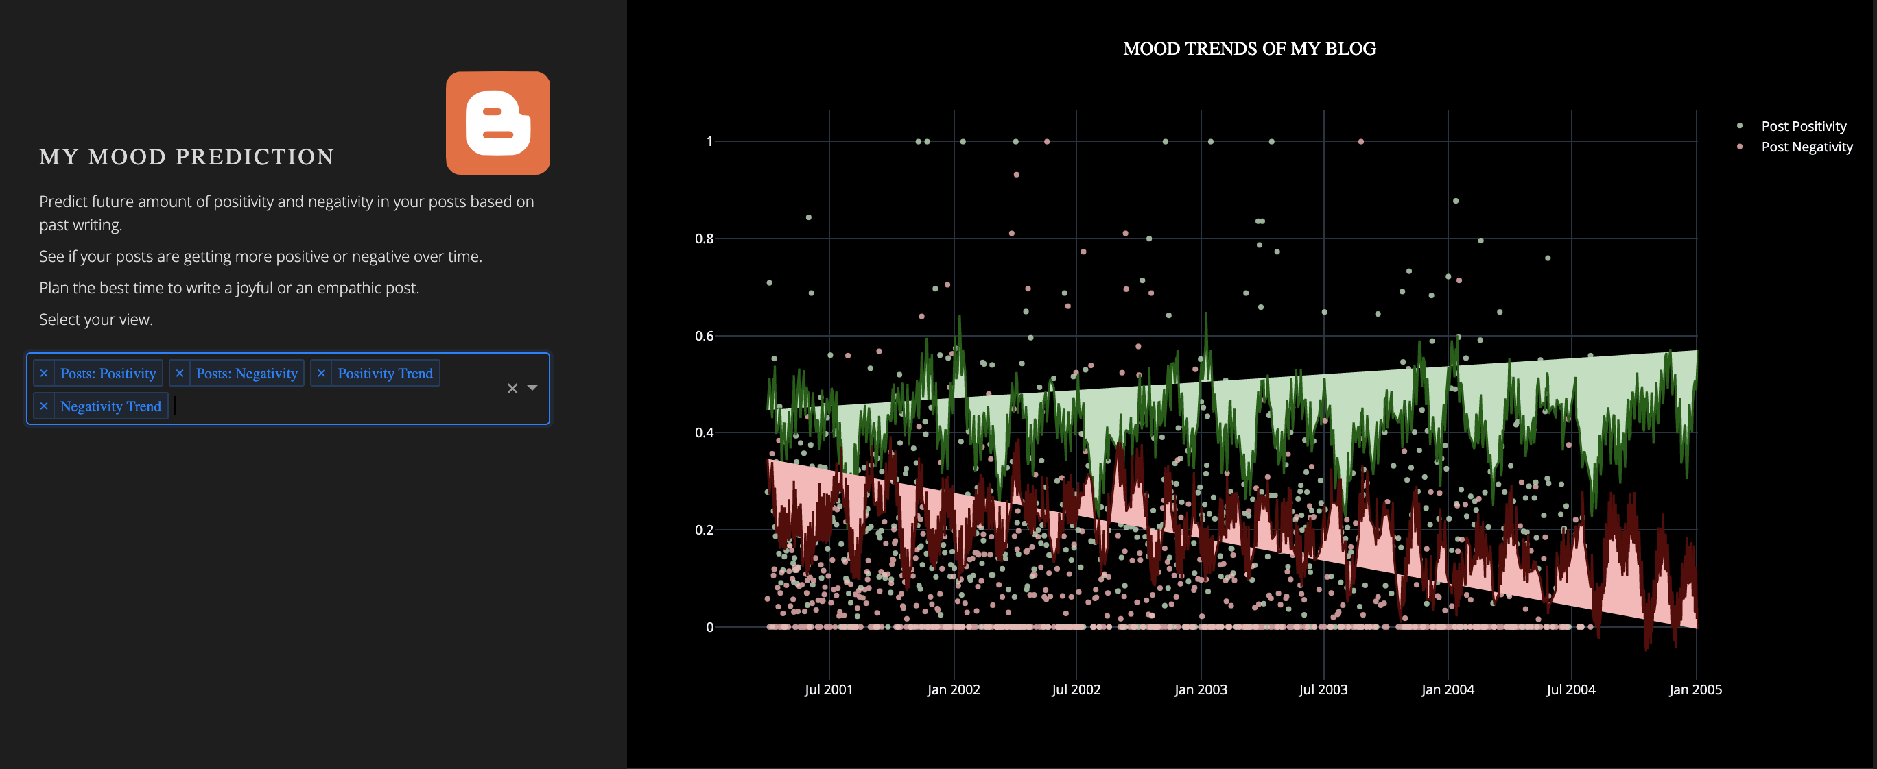
Bblogger Boost: Emotional Profile

